Slide 1


Joao Victor Lotfi Barrera
February 21st, 2022

Slide 2

Outline
Executive Summary
Introduction
Methodology
Results
Conclusion
Appendix

Slide 3
Executive Summary
The goal of this project is to use SpaceX's data to create a machine learning model which can predict whether the first stage of a rocket launch will successfully land back to Earth.
The data was collected using SpaceX's API and Web-scraping.
After cleaning, exploring, and visualizing the data, we were able to observe that succeeding has become more likely each upcoming year due to newer technologies. Also, higher payload masses, choosing specific launch sites, and father orbits all contributed greatly to landing it back.
Four machine learning models were tested. Logistic Regression, Support Vector Machine, K Nearest Neighbours, and Decision Tree Classifier. They produced similar results, achieving an estimate of 83.33% of accuracy rate.

Slide 4
Introduction
Context:
Commercial Space Age is now here. With the latest technologies, the space industry has become powerful as it has never been. However, costs of launch remain a key barrier for scalability.
SpaceX has best pricing ($62 million vs ~$165 million) because its technology allows for the possible recovery of the first stage piece, which can be later reused.
The problem:
How can we use past data from SpaceX to boost a new competitor called SpaceY, which could predict which factors influence the success rate of recovery?

Slide 5

Section 1

Slide 6
Methodology
Executive Summary
Data collection methodology:
Accessing the JSON result from SpaceX's API, and using beatifulsoup4 library to web-scrape data from Wikipedia's tables.
Perform data wrangling
Reducing the landing column class labels to 0's and 1's, which mean failed and success, respectively.
Perform exploratory data analysis (EDA) using visualization and SQL
Perform interactive visual analytics using Folium and Plotly Dash
Perform predictive analysis using classification models
Standardizing values and using one-hot encoding to better utilize categorical data, splitting dataset into train/test sets, using 4 model types (SVM, Tree, KNN, and LR), tuning them with GridSearchCV, using r^2 to get accuracy rates, and comparing results in a combined table.

Slide 7
Data Collection
Data collection originated from 2 paths:
- SpaceX's API
- Wikipedia's page for SpaceX's launches.
The following slides will present flow charts for each of the two processes.

Slide 8
Data Collection – SpaceX API
Here you can visualize how the process of getting data from the API went.
Here you can find the GitHub URL for the completed notebook containing SpaceX's API work.
Fetch JSON from SpaceX's API using python's requests library
Parse into Pandas' dataframe
Organize, rename, and fetch additional data from separate API's endpoints
Filter Data
Export Data

Slide 9
Data Collection - Scraping
Here you can visualize how the process of scrapping data from the html of a page went.
Here you can find the GitHub URL for the completed notebook containing Wikipedia's table web-scraping work.
Use beatifulsoup4 to scrape html from Wikipedia's page and find tables
Create a Pandas' dataframe using table's header elements as column names
Filter Data
Find table rows and parse each one to it's respective column
Export Data

Slide 10
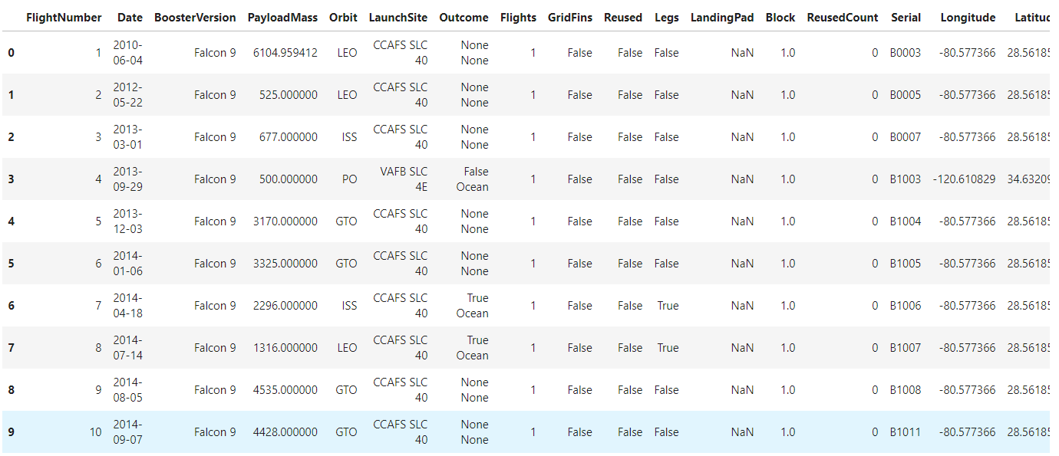
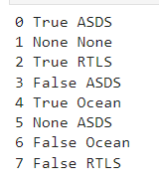
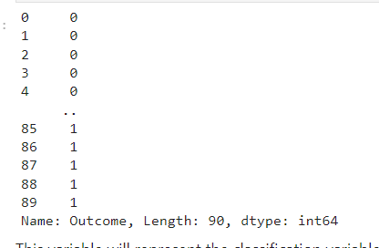
Data Wrangling
Used Exploratory Data Analysis to find patterns in the dataset and define labels for the outcome.
The dataset had a column containing categorical data for all the outcomes. For example, "True ASDS" meant it was a success and it landed on a drone ship. Knowing that, we could reduce all the categorical data to 0's (fail) and 1's (success).
Load Dataset Find unique outcomes Transform data
Here you can find the completed notebook for all the data wrangling work.

Slide 11
EDA with Data Visualization
To better understand the patterns hidden in this stream of data, we explored a few different charts. Here you can see which ones and what for:
Scatter Plot:
Flight Number vs Payload Mass (hue Class)
Flight Number vs Launch Site (hue Class)
Launch Site vs Payload Mass (hue Class)
Flight Number vs Orbit Type (hue Class)
Payload Mass vs Orbit Type (hue Class)
Bar Chart:
Orbits vs Avg Success Rate
Line Chart:
Year vs Avg Success Rate
To view the data visualization process, follow this link.

Slide 12
EDA with SQL
To solidify our knowledge on the dataset, we performed a few SQL queries to the dataset to filter and order by quite specific data. They are as follows:
To see how we used SQL queries to explore the dataset, visit this link.
Display the names of the unique launch sites in the space mission
Display 5 records where launch sites begin with the string 'CCA'
Display the total payload mass carried by boosters launched by NASA (CRS)
Display average payload mass carried by booster version F9 v1.1
List the date when the first successful landing outcome in ground pad was achieved
List the names of the boosters which have success in drone ship and have payload mass greater than 4000 but less than 6000
List the total number of successful and failure mission outcomes
List the names of the booster versions which have carried the maximum payload mass
List the failed landing outcomes in drone ship, their booster versions, and launch site names for in year 2015
Rank the count of landing outcomes (such as Failure (drone ship) or Success (ground pad)) between the date 2010-06-04 and 2017-03-20, in descending order

Slide 13
Build an Interactive Map with Folium
To further explore the data, we built an interactive map using Folium, a python library.
We marked all launch sites, then added a marker cluster to each one of them. These marker clusters contained green markers for successful missions, and red markers for failed missions, for its correspondent launch site. With this, we can better visualize how each launch site did in terms of performance.
Then, we marked points of interest and calculated the distance between it and a launch site. These points of interest were closest coastline, railway, highway, and city. This way we could observe that launch sites are usually close to coastlines, railways, and highways but are far away from cities.
To see how we created interactive maps with Folium, visit this link.

Slide 14
Build a Dashboard with Plotly Dash
To consolidate our exploration, we made a dashboard using Ploty and Dash, which are python libraries.
This dashboard contained 2 graphs and 2 inputs. A change in the input updates the graphs immediately.
These graphs were a pie chart for successful launches, and a scatter plot for payload mass vs class (hue: booster version category).
One input was a dropdown menu in which you can select all launch sites or a specific launch site. The other input was a slider for the mass, which one can select the range allowed for mass, in Kilograms.
This helped answer the following questions:
Which site has the largest successful launches? KSC LC-39A with 10.
Which site has the highest launch success rate? KSC LC-39A with 76.9% success.
Which payload range(s) has the highest launch success rate? 2000 – 5500 kg.
Which payload range(s) has the lowest launch success rate? 0-2000 and 5500 – 7000kg.
To see how we built a dashboard using Plotly Dash, visit this link.

Slide 15
Predictive Analysis (Classification)
Split label column 'Class' from dataset
Fit and
transform features using Standard Scaler
Split data in train and test subsets
Score each model with R^2 and test subset
Tune each model using GridSearchCV
Create LogReg, SVM, Decision Tree, and KNN models
Visualize results with confusion matrixes
Create barplot using the four scores to compare results
Conclude that the models performed similarly
To see the predictive analysis and model building process, follow this link.

Slide 16
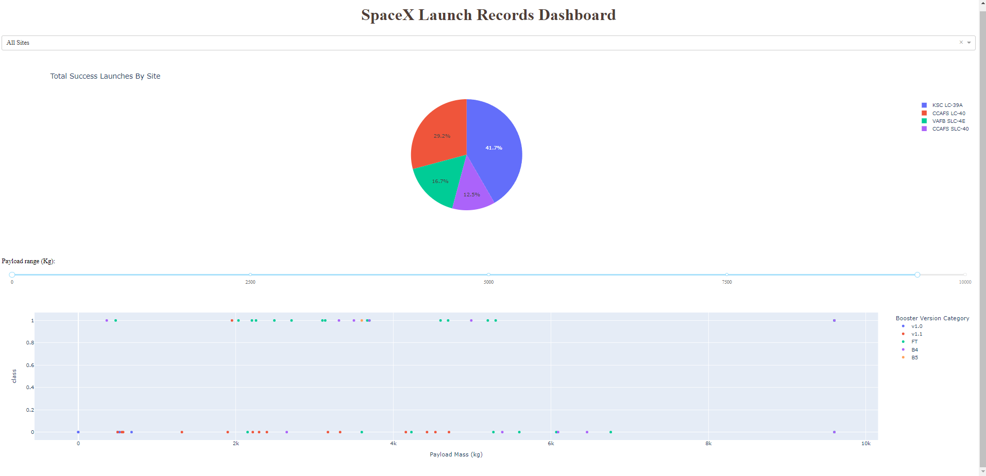
Results
In the picture above you can see a demo for our Plotly/Dash dashboard.
The result for the predictive analysis process was that the models performed almost the same, with a success rate of 83.33%
The following slides will show you a more in-depth analysis to each portion of the exploratory data analysis process.

Slide 17

Section 2

Slide 18
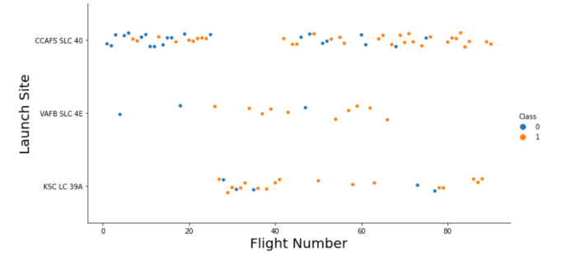
Flight Number vs. Launch Site
Success rates (Class 1) increases as the number of flights increase
For launch site ‘KSC LC 39A’, it takes at least around 25 launches before a first successful launch

Slide 19
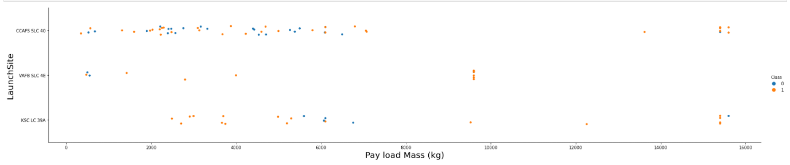
Payload vs. Launch Site
Most payloads have a mass between 0 and 6000kg.
Above about 9000 kg we can see that the ratio from successful landings to unsuccessful landings increases in comparison to lower payload masses

Slide 20
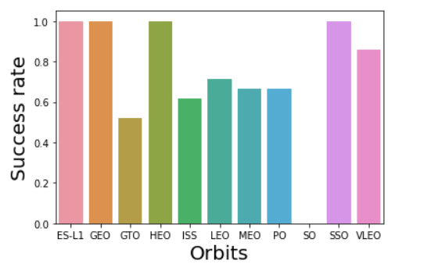
Success Rate vs. Orbit Type
ES-L1, GEO, HEO, SSO and VLEO have the highest success rates

Slide 21
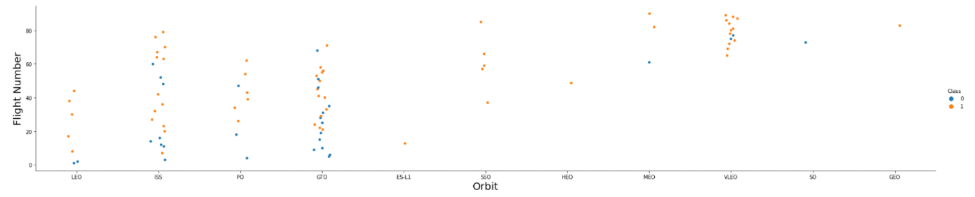
Flight Number vs. Orbit Type
In the LEO orbit the success appears related to the number of flights
On the other hand, there seems to be no relationship between flight number when in GTO orbit

Slide 22
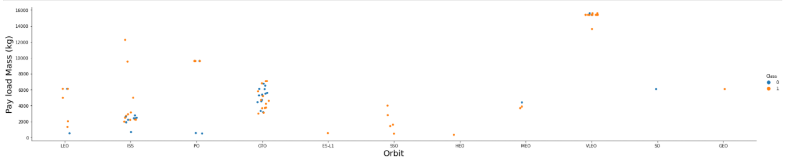
Payload vs. Orbit Type
With heavy payloads the successful landing or positive landing rate are more for Polar, LEO and ISS.
However for GTO we cannot distinguish this well because succesful and unsucessful launches happened at the same payload mass range.

Slide 23
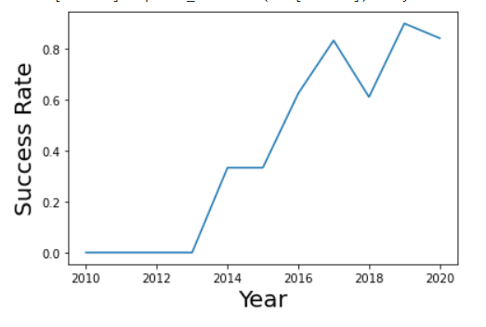
Launch Success Yearly Trend
The figure shows how success rates have gone up significantly each year.
In 2019 there was a dramatic decrease in success rates (by about 20%).

Slide 24
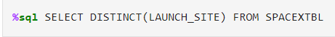
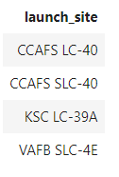
All Launch Site Names
In order to display the names of the unique launch sites in the space mission, input the following query:
The result is this:
This query fetches all distinct items from the launch_site column.

Slide 25
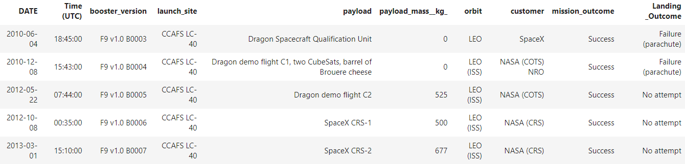
Launch Site Names Begin with 'CCA'
In order to display 5 records where launch sites begin with the string 'CCA', input the following query:
The result is this:
This query selectes everything from all rows where the start of each element in the column launch_site is "CCA", then limits results by the 5 first elements.

Slide 26
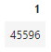
Total Payload Mass
In order to display the total payload mass carried by boosters launched by NASA (CRS), input the following query:
The result is this:
This query sums all values from the payload_mass column where the costumer is NASA.

Slide 27
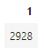
Average Payload Mass by F9 v1.1
In order to display average payload mass carried by booster version F9 v1.1, input the following query:
The result is this:
This query averages the entire payload_mass column where the booster version is equal to "F9 v1.1".

Slide 28
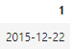
First Successful Ground Landing Date
In order to display the date when the first successful landing outcome in ground pad was achieved, input the following query:
The result is this:
This query selects the smallest date from the date column where the values in the column landing_outcome start with "Success".

Slide 29
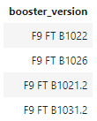
Successful Drone Ship Landing with Payload between 4000 and 6000
In order to list the names of the boosters which have success in drone ship and have payload mass greater than 4000 but less than 6000, input the following query:
The result is this:
This query selects the booster_version column where the values in the landing_outcome column are equal to "Success (drone ship)" AND the values in the payload_mass column are between 4000 and 6000.

Slide 30
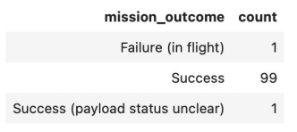
Total Number of Successful and Failure Mission Outcomes
In order to list the total number of successful and failure mission outcomes, input the following query:
The result is this:
This query selects the mission_outcome column and creates a new column count which contains the amount of rows for each unique value in the mission_outcome column.

Slide 31
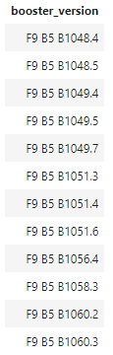
Boosters Carried Maximum Payload
In order to list the names of the booster versions which have carried the maximum payload mass, input the following query:
The result is this:
This query finds all the distinct values in the booster version column where the value in the payload mass column is equal to the max value found also in the payload mass column.

Slide 32
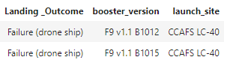
2015 Launch Records
In order to list the failed landing outcomes in drone ship, their booster versions, and launch site names for in year 2015, input the following query:
The result is this:
This query selects the items for the landing outcome, booster version, and launch site columns where the value in the landing outcome column is "failure (drop ship)" AND the value for the year in the date column is equal to 2015.

Slide 33
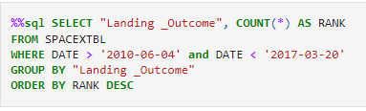
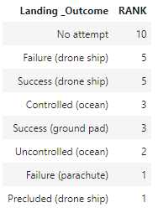
Rank Landing Outcomes Between 2010-06-04 and 2017-03-20
In order to rank the count of landing outcomes between the date 2010-06-04 and 2017-03-20, in descending order, input the following query:
The result is this:
This query selects the landing outcome column and creates a new column RANK which contains the amount of rows for each unique value in the landing outcome column where the values in the date column are between 2010-06-04 and 2017-03-20, then orders it in descending order.

Slide 34

Section 3

Slide 35
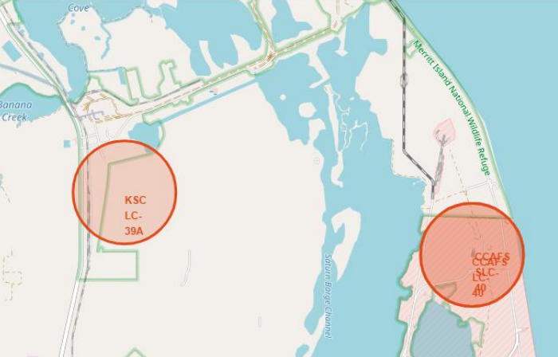
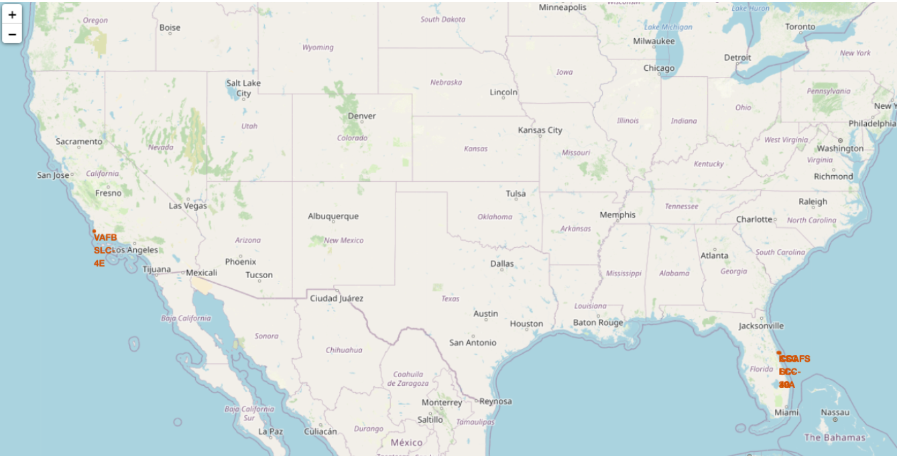
Launch Sites marked on the map
We can see on the map that both launch sites are in the US. However, only one is located in the west coast, while the other three are located in the east coast.
We also observed that CCAFS SLC-40 and CCAFS LC-40 are located right next to each other.

Slide 36
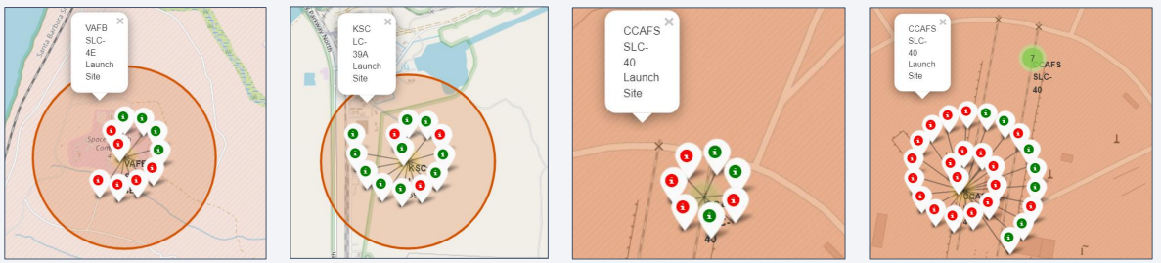
Marker Clusters with Success/Failed
By creating marker groups with color coding, we can observe that KSC LC-39A had the highest success to fail rate
On the other hand, CCAFS SLC-40 had the greatest amount of data points but the lowest success to fail rate.

Slide 37
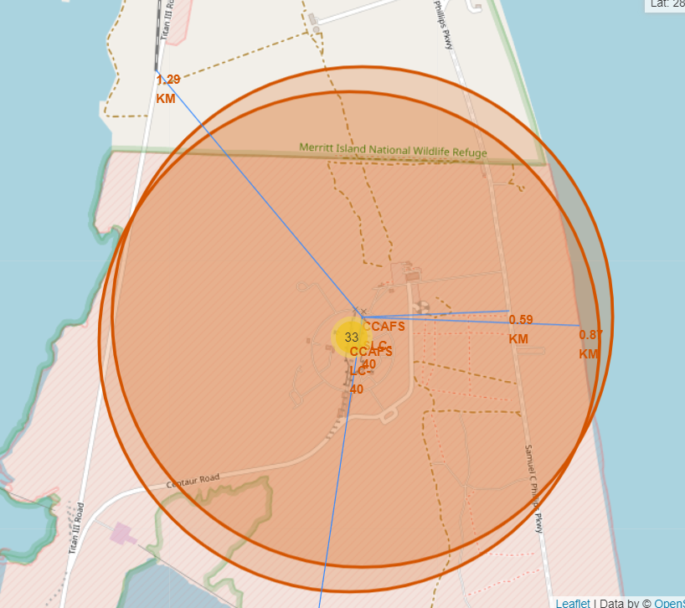
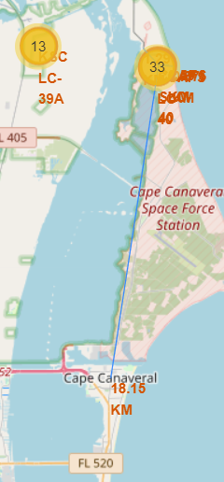
Distance to Points of Interest
Here we can clearly observe that launch sites are usually close to coast lines, railways, and highways but are quite far from cities.

Slide 38

Section 4

Slide 39

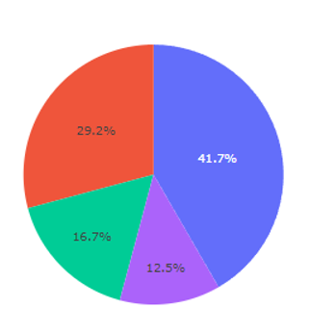
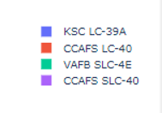
Launch Success for All Launch Sites
The data for total successful launches by site is as follows:
KSC LC-39A: 41.7%
CCAFS LC-40: 29.2%
VAFB SLC-4E: 16.7%
CCAFS SLC-40: 12.5%
As we can see, KSC LC-39A had the highest amount of successful launches among all launch sites.

Slide 40
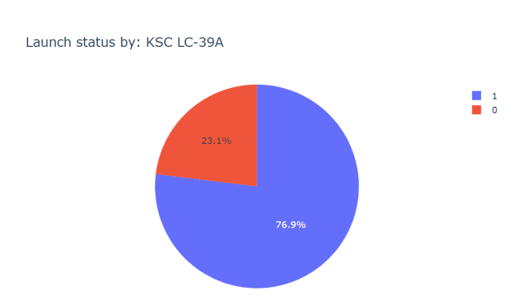
Success Rate Distribution for Highest Success Launch Site
For this graph, you can see KSC LC-39A is detaily analyzed.
From all launches in this site, 76.9% succeed and 23.1% failed to land the booster.

Slide 41
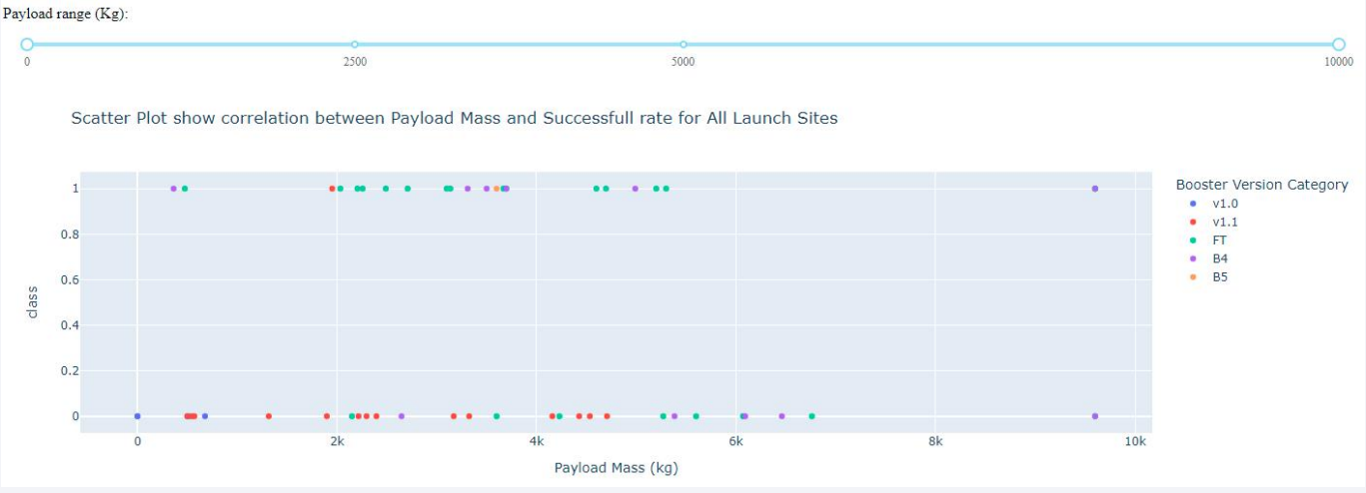
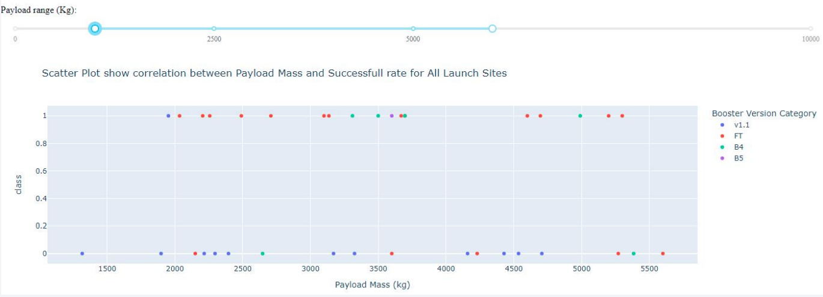
Mass vs Class Scatterplot for different Mass Ranges
Here we can see the correlation between payload mass and success/fail.
Most succesful launches have payload masses from 2000 to 5500 kg.
Fails are more likely to occur when the payload mass is less than 2000kg, or above 5500kg.

Slide 42

Section 5

Slide 43
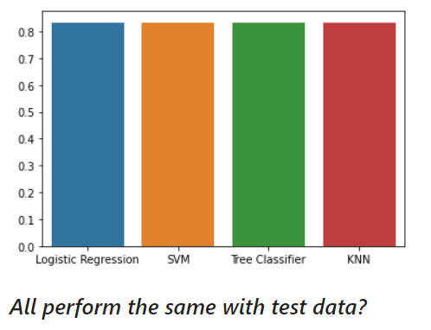
Classification Accuracy
This bar plot demonstrates how each model performed in terms of accuracy.
As we can see, they all performed equally, with an accuracy rate of 83.33%. Because of that, we can choose any model.

Slide 44

Confusion Matrix
All models produced equal accuracy rates.
The picture on the side stands for the confusion matrix created for the tree classifier model (picked randomly).
Using the matrix we can visualize that for the 18 entries, 15 were predicted correctly and 3 were false positives.

Slide 45
Conclusions
SpaceY successfully predicts which boosters will land with a small margin of error, and is able to observe which features contribute to this result, making it possible to direct resources to the correct areas. Some of these observations are:
As time passes, more and more rockets are launched, technology improves and success rates increase.
Launch Sites are strategically chosen far away from cities and close to coast lines.
The "KSC LC-39A" launch site performed the best.
ES-L1, GEO, HEO, SSO, and VLEO orbits have the highest success rates.
All tested classification models presented equal results, at 83.33% accuracy rate.
We should collect more data to improve our model's accuracy and lifespan.

Slide 46
Appendix
For all notebooks and source code, visit my GitHub repository here.
Salute to matplotlib, pandas, numpy, plotly, dash, folium, and beautifulsoup4 for being of use in this project.

Slide 47


